Slide 1
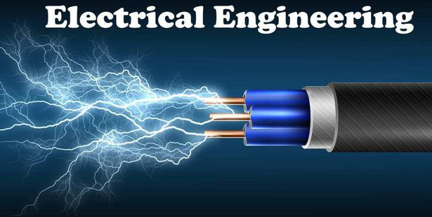


Slide 2
LECTURE 1

Slide 3
Electrical Technology (EEC-01)
SYLLABUS
Fundamentals of Electric Circuits: Ohm’s laws, Kirchhoff’s laws, Independent and Dependent sources, Analysis of simple circuits.
Network Theorems: Superposition theorem, Reciprocity theorem, Thevenin’s and Norton’s theorem, Maximum Power Transfer theorem.
Magnetic field, Concept of magnetic circuits, Magnetomotive force, Reluctance, Ampere’s circuital law and Biot-Savart law, Determination of B/H curve, Comparison of electric and magnetic circuit, Electromagnetic induction, Faraday’s laws of electromagnetic induction, Direction and Magnitude of induced E.M.F.
Self and mutual Inductance, Inductances in series and parallel, Energy stored in inductor, Capacitance, Capacitance in series and parallel, Relationship between charge, voltage and current, Energy stored in capacitor.
Transients with D.C. excitation.

Slide 4
Electrical Technology (EEC-01)
SYLLABUS
Generation of alternating voltage and current, E.M.F. equation, Average and R.M.S. value, Phase and phase difference, Phasor representation of alternating quantity, Behaviour of A.C. circuits, Resonance in series and parallel R-L-C circuits.
Single-Phase Transformer, equivalent circuits, open circuit and short circuit tests.
Poly phase system, Advantages of 3-phase system, Generation of 3-phase voltages, Voltage, current and power in a star and delta connected systems, 3-phase balanced and unbalanced circuits, Power measurement in 3-phase circuits.
Text Books:
1. Electrical & Electronic Technology by Hughes, Pearson Education India.
Reference Books:
1. Advanced Electrical Technology by H. Cotton, Reem Publication Pvt. Ltd
2. Electrical Engineering fundamentals by Vincent Deltoro, Pearson Education India.
1.

Slide 5
Electrical Technology (EEC-01)
Another Reference Books:
Electrical Engineering Concepts and Applications by S. A. Reza Zekavat;
Fundamentals of Electric Circuits by Charles K Alexander & Mathew N O Sadiku;
Electrical and Electronic Technology by Edward Hughes;
Electrical Circuits by Hyte and Kamarly;
Basic Electric Circuit Analysis by David E. Johnson, John L. Hilburn, Johnny R. Johnson and Peter D. Scott.
Engineering Circuit Analysis by J. David Irwin and Robert M. Nelms;
Linear Circuit Analysis by Raymond A. De Carlo and Pen-Min Lin.
Circuits and Networks by M.S. Sukhija and T. K. Nagsarkar;
Network Analysis by M.E. Van Valkenburg;
Networks and Systems by D. Roy Choudhury.
A text book of Electrical Technology by B. L. Thereja and A. K. Thereja;
Circuit Theory (Analysis and Synthesis) by A. Chakrabarty.

Slide 6
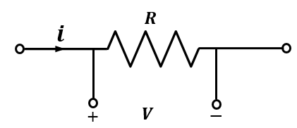
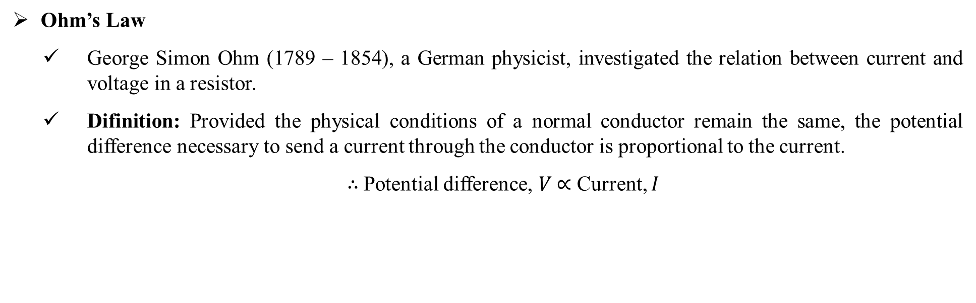
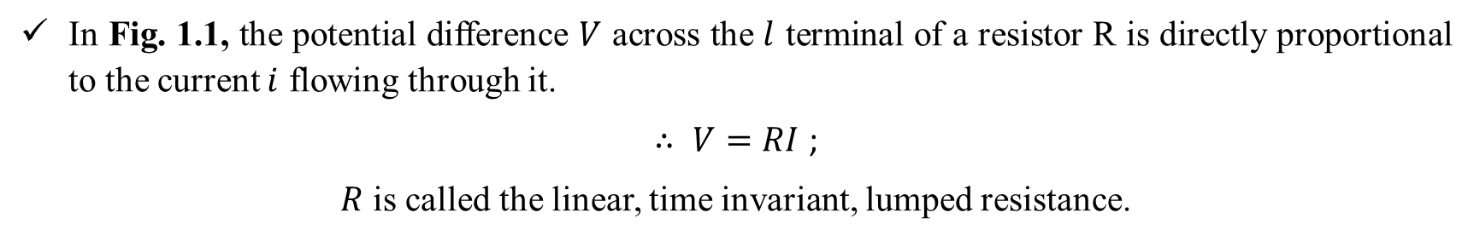
Fundamentals of Electric Circuits
Ohm’s Law
George Simon Ohm (1789 – 1854), a German physicist, investigated the relation between current and voltage in a resistor.
Difinition: Provided the physical conditions of a normal conductor remain the same, the potential difference necessary to send a current through the conductor is proportional to the current.
$∴$Potential difference, $V$ $∝$ Current, $I$
Fig. 1.1. Voltage-Current Relationship of a Resistor
In Fig. 1.1, the potential difference $V$ across the $l$ terminal of a resistor R is directly proportional to the current $i$ flowing through it.
$∴$ $V=RI$ ;
$R$ is called the linear, time invariant, lumped resistance.
1

Slide 7
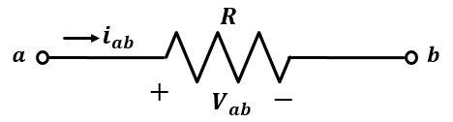
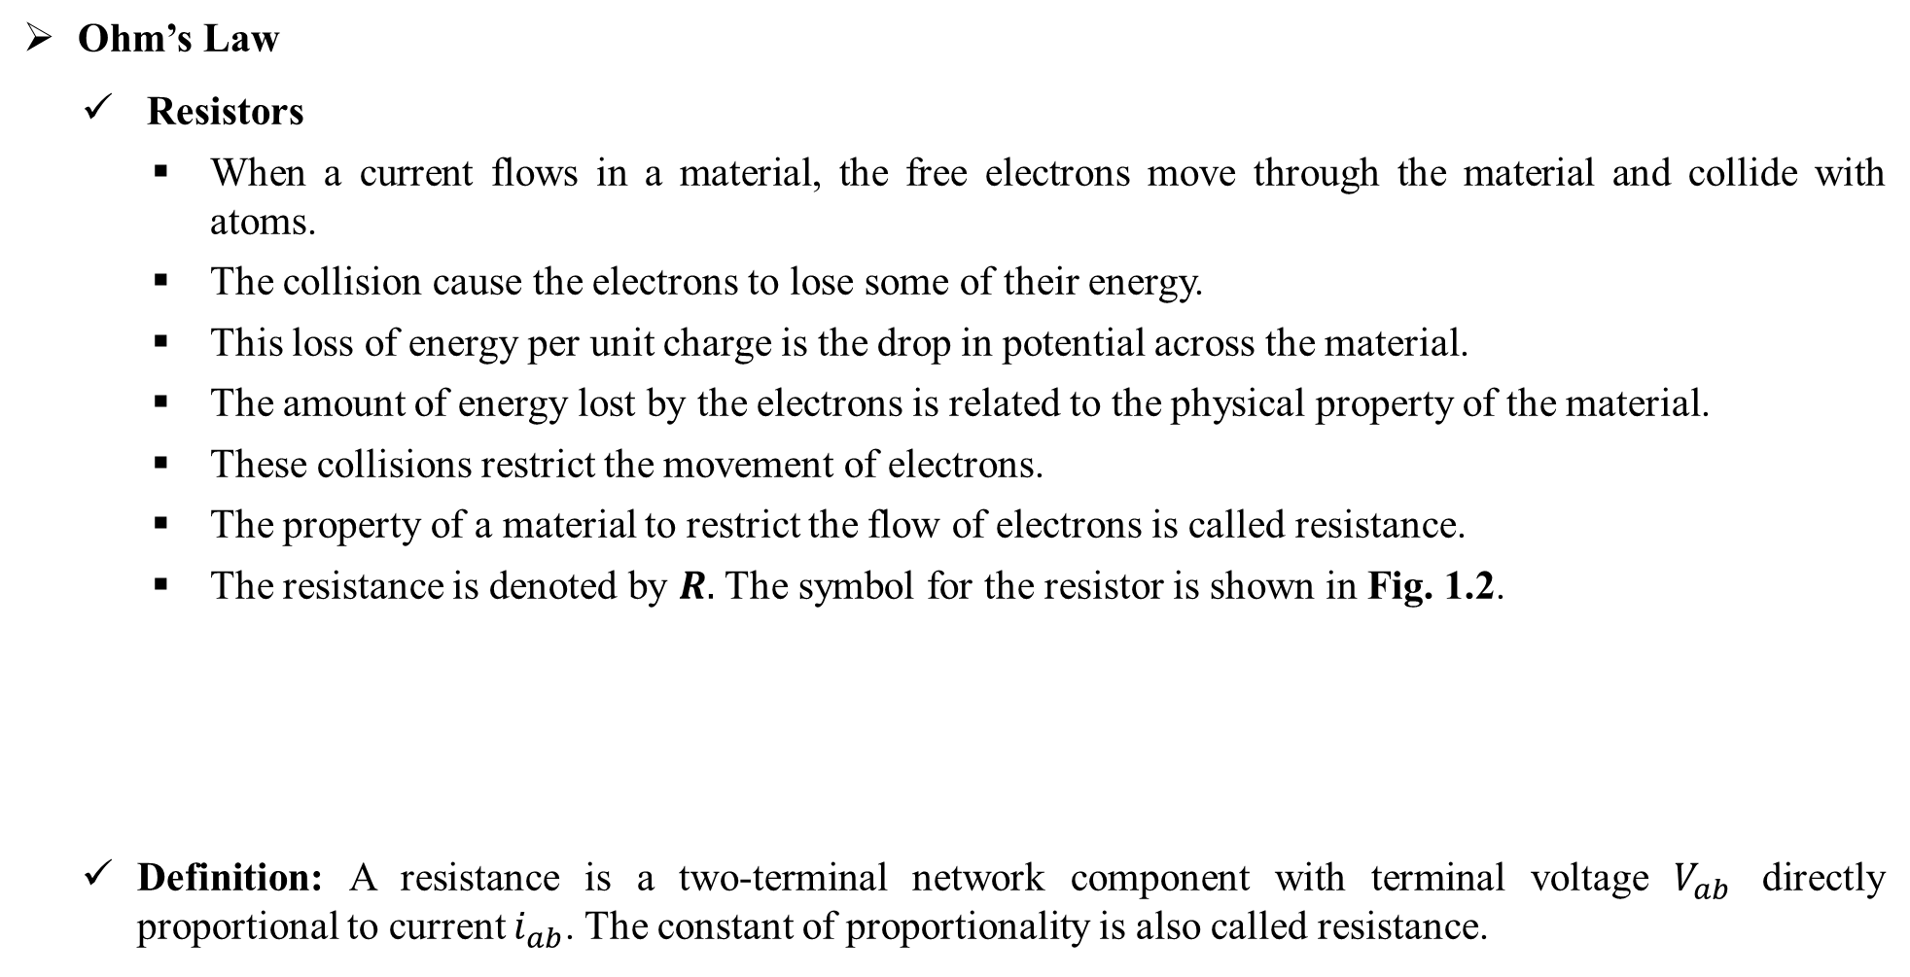
Fundamentals of Electric Circuits
Ohm’s Law
Resistors
When a current flows in a material, the free electrons move through the material and collide with atoms.
The collision cause the electrons to lose some of their energy.
This loss of energy per unit charge is the drop in potential across the material.
The amount of energy lost by the electrons is related to the physical property of the material.
These collisions restrict the movement of electrons.
The property of a material to restrict the flow of electrons is called resistance.
The resistance is denoted by $R.$ The symbol for the resistor is shown in Fig. 1.2.
Definition: A resistance is a two-terminal network component with terminal voltage $V_{ab}$ directly proportional to current $i_{ab}$. The constant of proportionality is also called resistance.
Fig. 1.2. Symbol of resistor
2

Slide 8
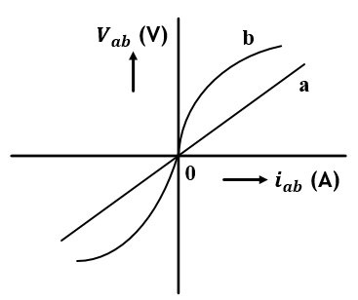
Fundamentals of Electric Circuits
Ohm’s Law
Resistors
The unit of resistance is ohm (Ω).
Ohm is defined as the resistance offered by the material when a current of one ampere flows between two terminals with one volt applied across it.
The volt ampere plot of a linear resistor is a straight line and that of many devices are nonlinear such as diode.
A resistor constructed of a semiconductor material such as silicon carbide have a characteristics of curve b in Fig. 3.
The device which exhibits nonlinear resistance is called a nonlinear resistor.
The resistor which is metallic conductor shows the voltage across the conductor is directly proportional to the current through it at constant temperature.
A resistor constructed of metal would obey ohm’s law and would have a characteristic that follow a straight line as given by a curve a of Fig. 1.3.
Fig. 1.3. Characteristics of resistor
3

Slide 9
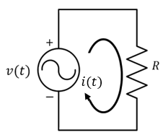
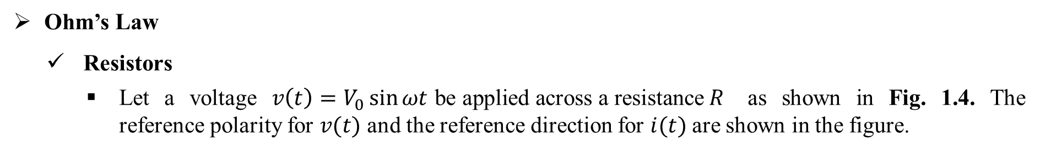
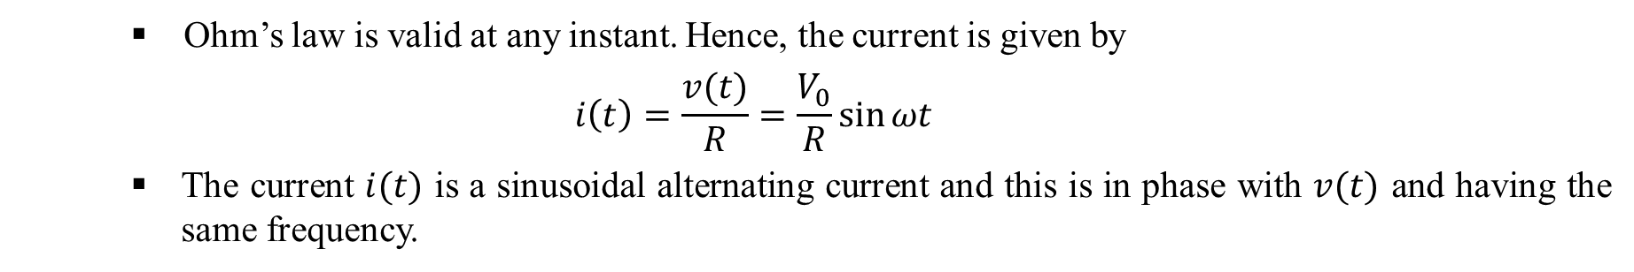
Fundamentals of Electric Circuits
Ohm’s Law
Resistors
Let a voltage $v\left(t\right)=V_{0}\sin{ωt \text{be} \text{applied} \text{across} \text{a} \text{resistance} R }$ as shown in Fig. 1.4. The reference polarity for $v(t)$ and the reference direction for $i(t)$ are shown in the figure.
Fig. 1.4. Sinusoidal Voltage applied to resistor
Ohm’s law is valid at any instant. Hence, the current is given by
$$i\left(t\right)=\frac{v(t)}{R}=\frac{V_{0}}{R}\sin{ωt}$$
The current $i(t)$ is a sinusoidal alternating current and this is in phase with $v(t)$ and having the same frequency.
4

Slide 10
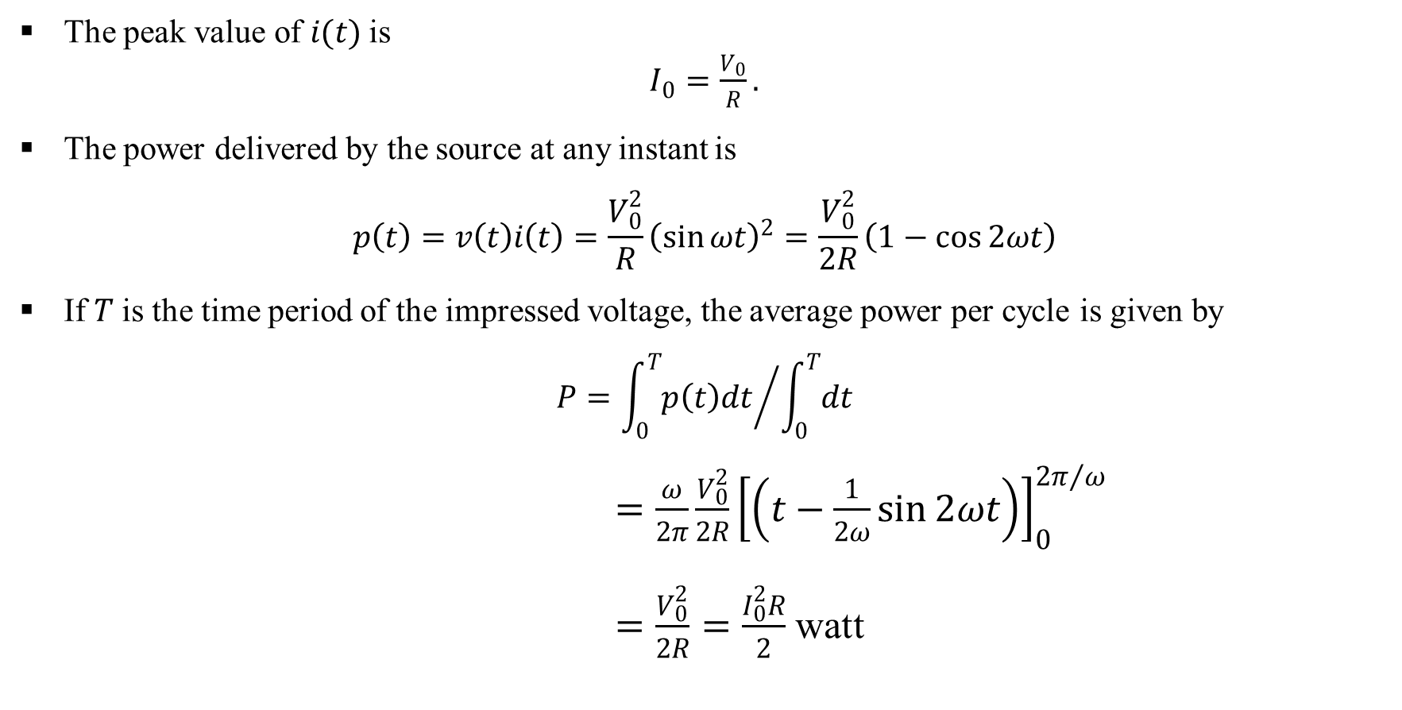
Fundamentals of Electric Circuits
Ohm’s Law
Resistors
The peak value of $i(t)$ is
$I_{0}=\frac{V_{0}}{R}.$
The power delivered by the source at any instant is
$$p\left(t\right)=v\left(t\right)i\left(t\right)=\frac{V_{0}^{2}}{R}{\left(\sin{ωt}\right)}^{2}=\frac{V_{0}^{2}}{2R}\left(1−\cos{2ωt}\right)$$
If $T$ is the time period of the impressed voltage, the average power per cycle is given by
$$P={\int_{0}^{T}{p\left(t\right)dt}}/{\int_{0}^{T}{dt}}$$
$=\frac{ω}{2π}\frac{V_{0}^{2}}{2R}{\left[\left(t−\frac{1}{2ω}\sin{2ωt}\right)\right]}_{0}^{{2π}/ω}$
$=\frac{V_{0}^{2}}{2R}=\frac{I_{0}^{2}R}{2}$ watt
5

Slide 11
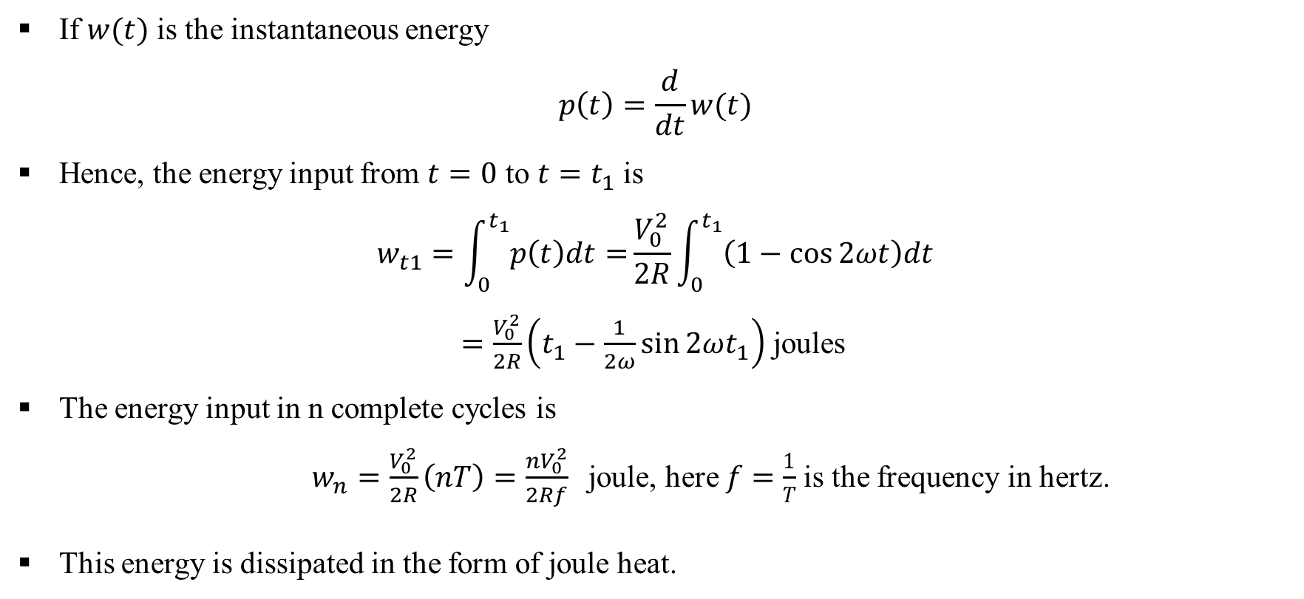
Fundamentals of Electric Circuits
Ohm’s Law
Resistors
If $w(t)$ is the instantaneous energy
$$p\left(t\right)=\frac{d}{dt}w(t)$$
Hence, the energy input from $t=0$ to $t=t_{1}$ is
$$w_{t1}=\int_{0}^{t_{1}}{p\left(t\right)dt=}\frac{V_{0}^{2}}{2R}\int_{0}^{t_{1}}{\left(1−\cos{2ωt}\right)dt}$$
$=\frac{V_{0}^{2}}{2R}\left(t_{1}−\frac{1}{2ω}\sin{2ωt_{1}}\right)$ joules
The energy input in n complete cycles is
$w_{n}=\frac{V_{0}^{2}}{2R}\left(nT\right)=\frac{nV_{0}^{2}}{2Rf}$joule, here $f=\frac{1}{T}$is the frequency in hertz.
This energy is dissipated in the form of joule heat.
6

Slide 12
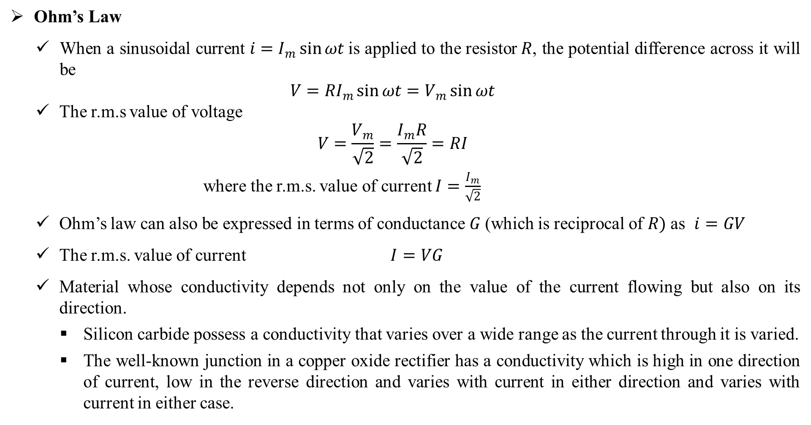
Fundamentals of Electric Circuits
Ohm’s Law
When a sinusoidal current $i=I_{m}\sin{ωt }$is applied to the resistor$R$, the potential difference across it will be
$$V=RI_{m}\sin{ωt}=V_{m}\sin{ωt}$$
The r.m.s value of voltage
$$V=\frac{V_{m}}{\sqrt{2}}=\frac{I_{m}R}{\sqrt{2}}=RI$$
where the r.m.s. value of current $I=\frac{I_{m}}{\sqrt{2}}$
Ohm’s law can also be expressed in terms of conductance $G$ (which is reciprocal of $R)$ as $i=GV$
The r.m.s. value of current $I=VG$
Material whose conductivity depends not only on the value of the current flowing but also on its direction.
Silicon carbide possess a conductivity that varies over a wide range as the current through it is varied.
The well-known junction in a copper oxide rectifier has a conductivity which is high in one direction of current, low in the reverse direction and varies with current in either direction and varies with current in either case.
7

Slide 13
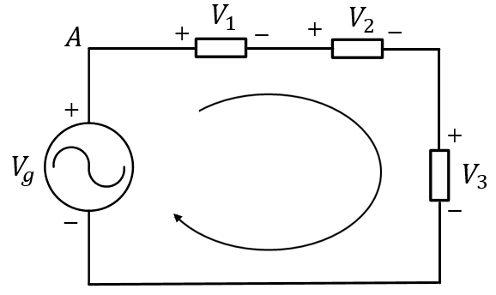
Fundamentals of Electric Circuits
Kirchhoff’s Law
Electric circuit theory is based on two fundamental laws introduced by Kirchhoff.
These are Kirchhoff’s Voltage Law (abbreviated KVL) and Kirchhoff’s Current Law (abbreviated KCL)
Kirchhoff’s Voltage Law
It states that the algebraic sum of the voltage drops around any closed path of a circuit is zero at all instants of time.
In other words, around any closed path, at all instants of time, the sum of the voltage drops must equal the sum of the voltage rises.
A simple circuit is shown in Fig. 1.5 to illustrate the application of Kirchhoff’s Voltage Law.
The boxes contain the circuit elements. The reference polarities for voltages across the elements are shown.
Fig. 1.5. Circuit containing voltage source and circuit elements
8

Slide 14
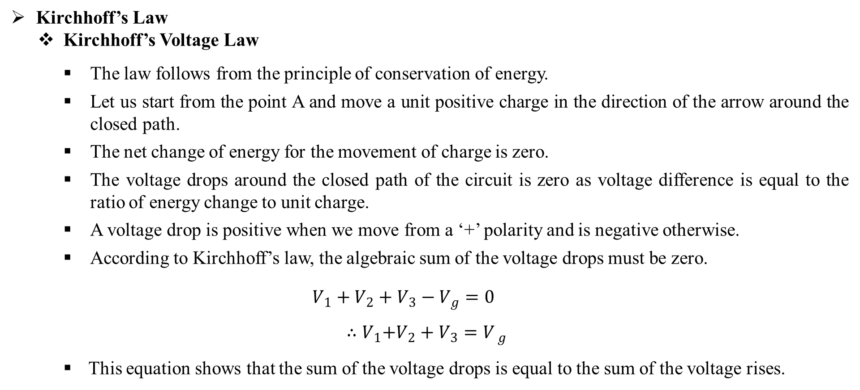
Fundamentals of Electric Circuits
Kirchhoff’s Law
Kirchhoff’s Voltage Law
The law follows from the principle of conservation of energy.
Let us start from the point A and move a unit positive charge in the direction of the arrow around the closed path.
The net change of energy for the movement of charge is zero.
The voltage drops around the closed path of the circuit is zero as voltage difference is equal to the ratio of energy change to unit charge.
A voltage drop is positive when we move from a ‘+’ polarity and is negative otherwise.
According to Kirchhoff’s law, the algebraic sum of the voltage drops must be zero.
$$V_{1}+V_{2}+V_{3}−V_{g}=0$$
$${ ∴V}_{1}+V_{2}+V_{3}=V_{ g}$$
This equation shows that the sum of the voltage drops is equal to the sum of the voltage rises.
9

Slide 15
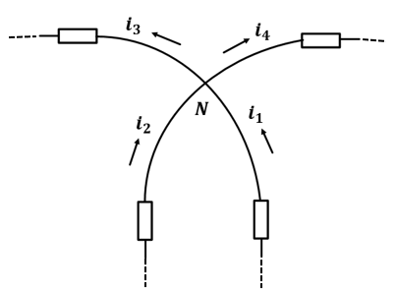
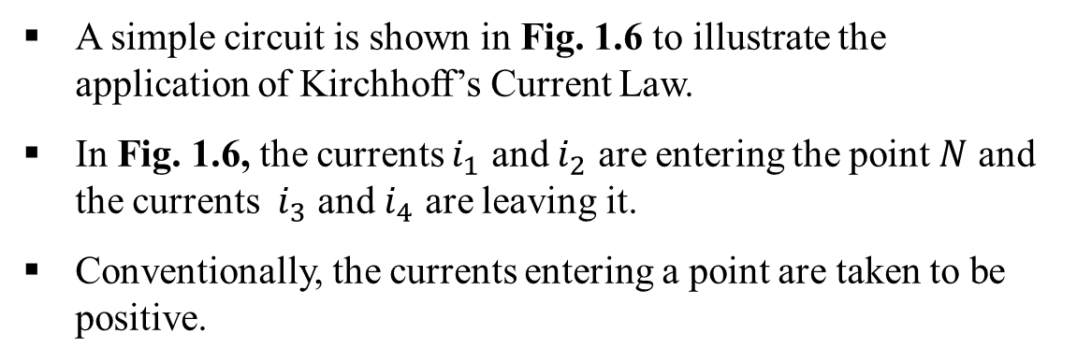

Fundamentals of Electric Circuits
Kirchhoff’s Law
Kirchhoff’s Current Law
It states that the algebraic sum of the currents entering a given point in a circuit is zero at all instants of time.
In other words, the sum of the currents entering a given point in a circuit equals the sum of the currents leaving that point at any instant of time.
This law is a consequence of the conservation of charge.
As charge can not accumulate at a point, the charge entering a point must leave it. The algebraic sum of the charge or its time derivative (which is the current) must thus be zero..
A simple circuit is shown in Fig. 1.6 to illustrate the application of Kirchhoff’s Current Law.
In Fig. 1.6, the currents $i_{1}$ and $i_{2}$ are entering the point $N$ and the currents $i_{3}$ and $i_{4}$ are leaving it.
Conventionally, the currents entering a point are taken to be positive.
Fig. 1.6. Currents meeting at node $N$
10

Slide 16
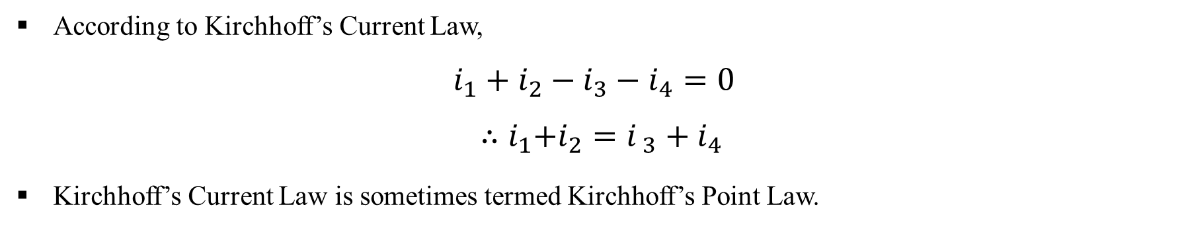
Fundamentals of Electric Circuits
Kirchhoff’s Law
Kirchhoff’s Current Law
According to Kirchhoff’s Current Law,
$$i_{1}+i_{2}−i_{3}−i_{4}=0$$
$${ ∴i}_{1}+i_{2}=i_{ 3}+i_{4}$$
Kirchhoff’s Current Law is sometimes termed Kirchhoff’s Point Law.
11

Slide 17
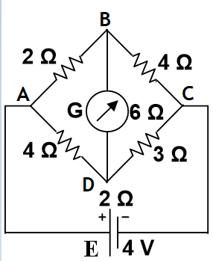
Fundamentals of Electric Circuits
Example – P1.1
Obtain the branch currents in the unbalanced bridge circuit of Fig. P1.1. Also determine the voltage drop across AC and the equivalent resistance between terminals A and C in the bridge circuit.
Fig. P1.1
12

Slide 18
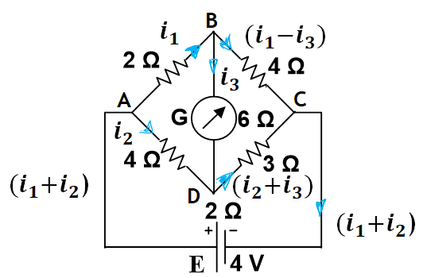

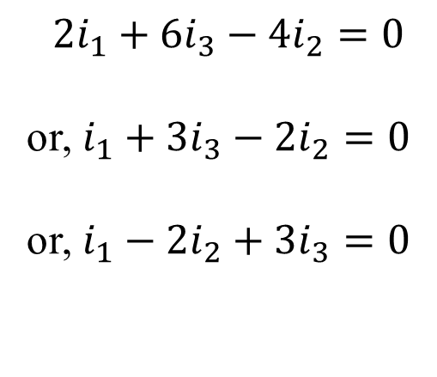

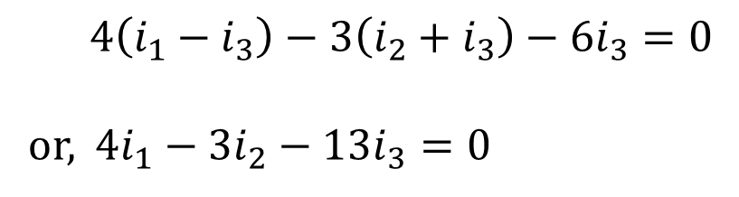
Fundamentals of Electric Circuits
Solution of Example – P1.1
The assumed direction of currents are shown in the figure.
Applying KVL in the loop ABDA, we get
$2i_{1}+6i_{3}−4i_{2}=0$
or, $i_{1}+3i_{3}−2i_{2}=0$
or, $i_{1}−2i_{2}+3i_{3}=0$
$$\left(1\right)$$
Applying KVL in the loop BCDB, we get
Fig. P1.1
$$4\left(i_{1}−i_{3}\right)−3\left(i_{2}+i_{3}\right)−6i_{3}=0$$
or, 4$i_{1}−3i_{2}−13i_{3}=0$
$$\left(2\right)$$
13

Slide 19

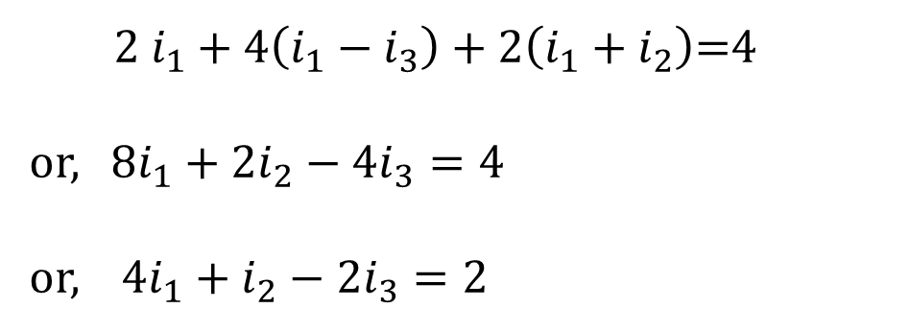

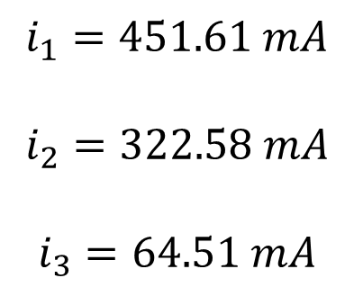

Fundamentals of Electric Circuits
Solution of Example – P1.1
Applying KVL in the loop ABCEA, we get
$2 i_{1}+4\left(i_{1}−i_{3}\right)+2\left(i_{1}+i_{2}\right)$=4
or, $8i_{1}+2i_{2}−4i_{3}=4$
or, $4i_{1}+i_{2}−2i_{3}=2$
$$\left(3\right)$$
Solving these equations $\left(1\right), \left(2\right)$ and ($3),$we get
$$i_{1}=451.61 mA$$
$$i_{2}=322.58 mA$$
$$i_{3}=64.51 mA$$
$$∴ \left(i_{1}+i_{2}\right)=i=774.19 mA$$
14

Slide 20
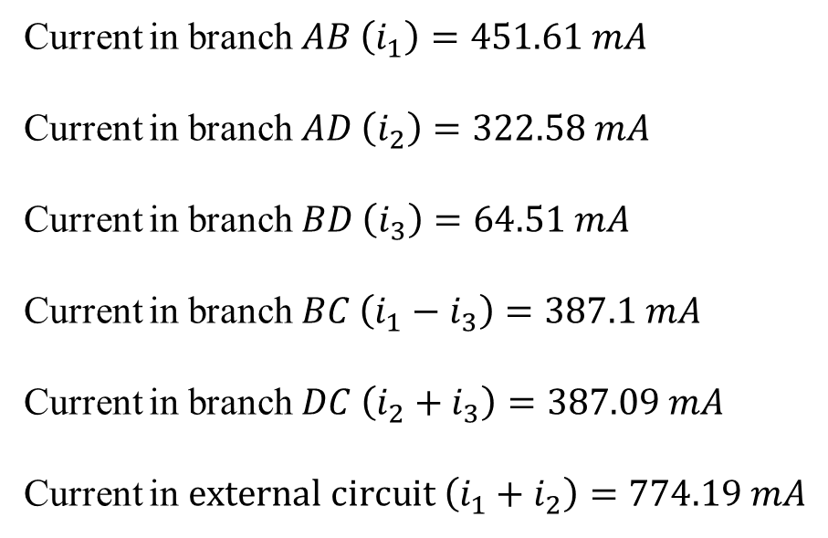
Fundamentals of Electric Circuits
Solution of Example – P1.1
Then the branch currents are as follows:
Current in branch $AB \left(i_{1}\right)=451.61 mA$
Current in branch $AD \left(i_{2}\right)=322.58 mA$
Current in branch $BD \left(i_{3}\right)=64.51 mA$
Current in branch $BC \left(i_{1}−i_{3}\right)=387.1 mA$
Current in branch $DC \left(i_{2}+i_{3}\right)=387.09 mA$
Current in $external circuit \left(i_{1}+i_{2}\right)=774.19 mA$
15

Slide 21
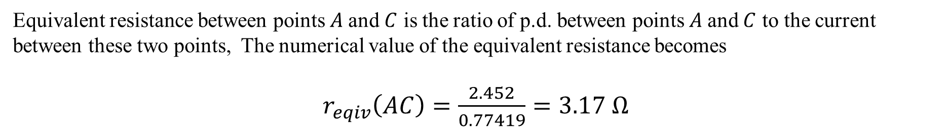
Fundamentals of Electric Circuits
Solution of Example – P1.1
The internal voltage drop of the cell being $\left[r_{int}\left(i_{1}+i_{2}\right)\right]$ $= \left(2×774.10\right)×{10}^{−3} V=1.55 V$
Equivalent resistance between points $A$and $C$ is the ratio of p.d. between points $A$and $C$ to the current between these two points, The numerical value of the equivalent resistance becomes
$r_{eqiv}\left(AC\right)=\frac{2.452}{0.77419}=3.17 Ω$
[∵ The p.d. between points $A$and $C$ = $\left(2×0.45161\right)+\left(4×0.3871\right)V=2.452 V]$
16

Slide 22
LECTURE 2

Slide 23
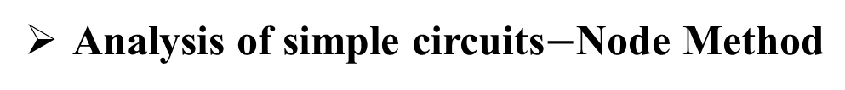
Fundamentals of Electric Circuits
Analysis of simple circuits$−\text{Node} \text{Method}$
The node method is based on kirchhoff’s current law (KCL).
The advantages of node method is that a minimum number of equations need to be solved to determine the unknown quantities.
Every junction in the network where two or more branches meet is regarded a node.
One of these is regarded as the reference node or datum node or zero potential node.
Hence, the number of simultaneous equations to be solved becomes (n-1) where n is the number of independent nodes.
These node equations often become simplified if all voltage sources are converted into current sources.
17

Slide 24
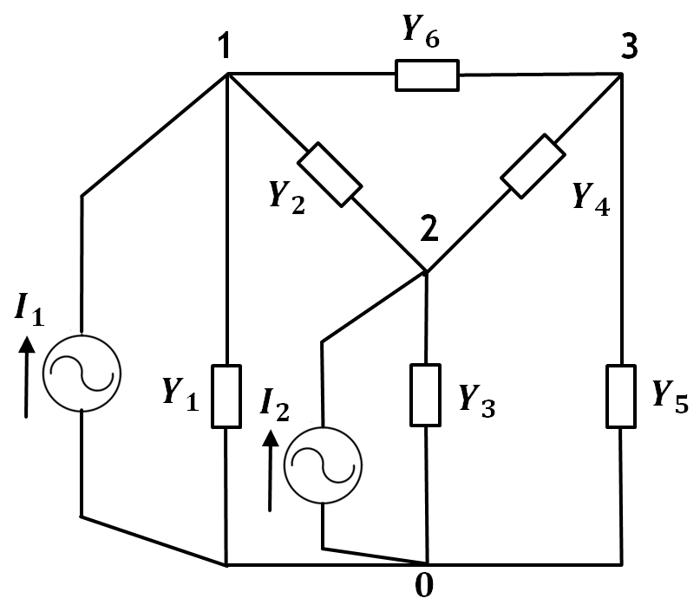
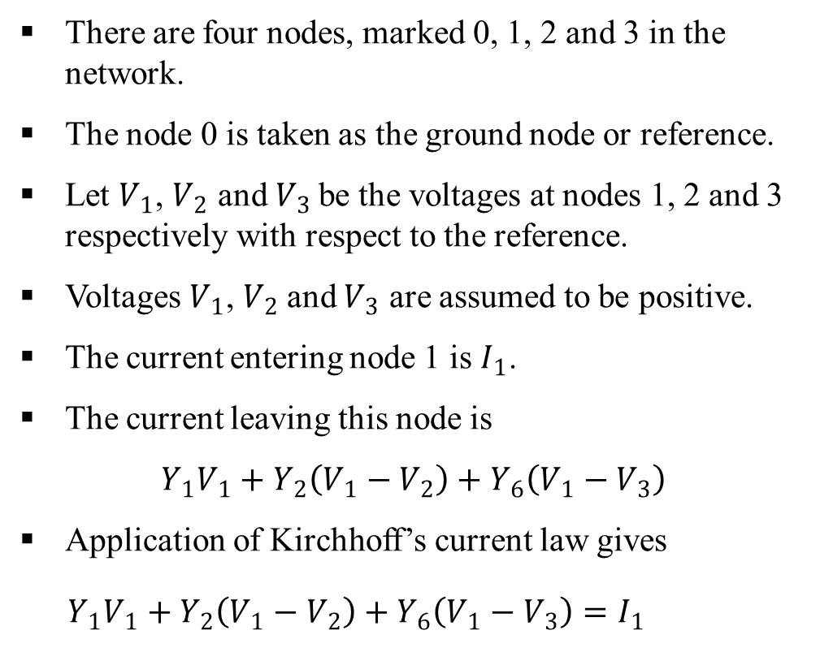
Fundamentals of Electric Circuits
Analysis of simple circuits$−\text{Node} \text{Method}$
The analysis of node method is illustrated through the circuit as shown in Fig. 1.7.
There are four nodes, marked 0, 1, 2 and 3 in the network.
The node 0 is taken as the ground node or reference.
Let $V_{1}$, $V_{2}$ and$V_{3}$ be the voltages at nodes 1, 2 and 3 respectively with respect to the reference.
Voltages $V_{1}$, $V_{2}$and $V_{3}$ are assumed to be positive.
The current entering node 1 is $I_{1}$.
The current leaving this node is
$$Y_{1}V_{1}+Y_{2}\left(V_{1}−V_{2}\right)+Y_{6}\left(V_{1}−V_{3}\right)$$
Application of Kirchhoff’s current law gives
$$Y_{1}V_{1}+Y_{2}\left(V_{1}−V_{2}\right)+Y_{6}\left(V_{1}−V_{3}\right)=I_{1}$$
Fig. 1.7. Circuit used for node analysis.
(1)
18

Slide 25
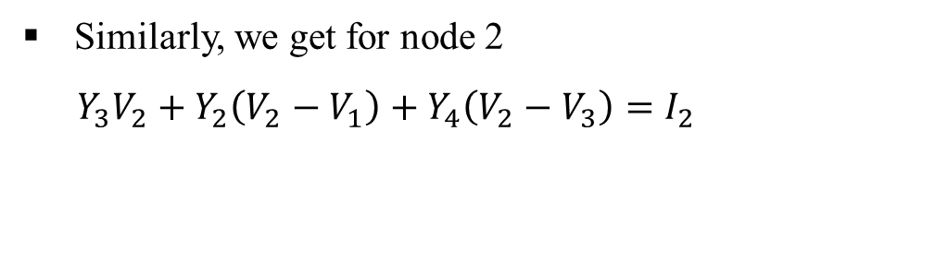
Fundamentals of Electric Circuits
Analysis of simple circuits$−\text{Node} \text{Method}$
Similarly, we get for node 2
$$Y_{3}V_{2}+Y_{2}\left(V_{2}−V_{1}\right)+Y_{4}\left(V_{2}−V_{3}\right)=I_{2}$$
(2)
and for node 3
$${ Y}_{5}V_{3}+Y_{4}\left(V_{3}−V_{2}\right)+Y_{6}\left(V_{3}−V_{1}\right)=0$$
(3)
Rearranging equations (1) through (3), we obtain
$$\left(Y_{1}+Y_{2}+Y_{6}\right){ V}_{1}−Y_{2}{ V}_{2}−Y_{6}{ V}_{3}=I_{1}$$
(4)
$$−Y_{2}{ V}_{1}+\left(Y_{2}+Y_{3}+Y_{4}\right){ V}_{2}−Y_{4}{ V}_{3}=I_{2}$$
(5)
$${−Y}_{6}{ V}_{1}−Y_{4}{ V}_{2}+\left(Y_{4}+Y_{5}+Y_{6}\right){ V}_{3}=0$$
(6)
Fig. 1.7. Circuit used for node analysis
The self-admittance of a node is defined as the sum of the admittances connected to that node.
In the example, $Y_{11}$=$Y_{1}+Y_{2}+Y_{6}$, $Y_{22}$=${ Y}_{2}+Y_{3}+Y_{4}$ and $Y_{33}$= $Y_{4}+Y_{5}+Y_{6}$.
19

Slide 26
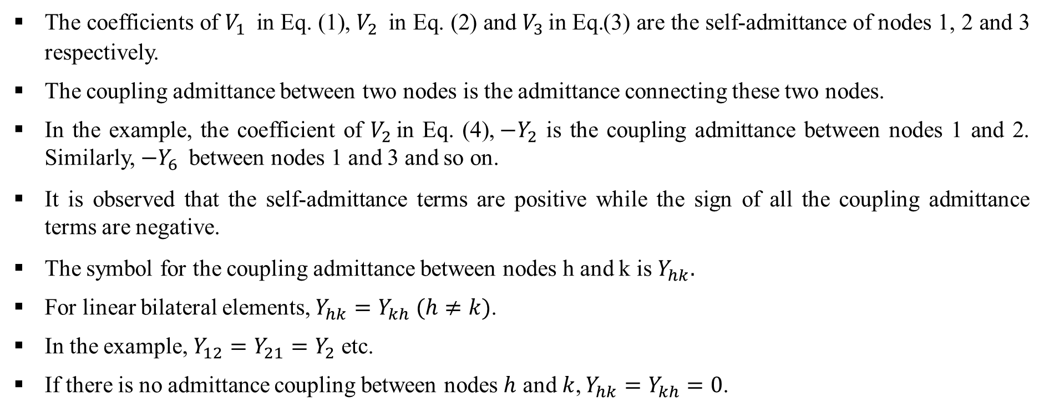
Fundamentals of Electric Circuits
Analysis of simple circuits$−\text{Node} \text{Method}$
The coefficients of $V_{1 }$ in Eq. (1), $V_{2 }$ in Eq. (2) and $V_{3 }\text{in} \text{Eq}\text{.}$(3) are the self-admittance of nodes 1, 2 and 3 respectively.
The coupling admittance between two nodes is the admittance connecting these two nodes.
In the example, the coefficient of $V_{2 }$in Eq. (4),$−Y_{2}$ is the coupling admittance between nodes 1 and 2. Similarly, $−Y_{6 }$ between nodes 1 and 3 and so on.
It is observed that the self-admittance terms are positive while the sign of all the coupling admittance terms are negative.
The symbol for the coupling admittance between nodes h and k is $Y_{hk}.$
For linear bilateral elements, $Y_{hk}=Y_{kh} (h≠k)$.
In the example, $Y_{12}=Y_{21}=Y_{2}$ etc.
If there is no admittance coupling between nodes $h$ and$k$, $Y_{hk}=Y_{kh}=0$.
20

Slide 27
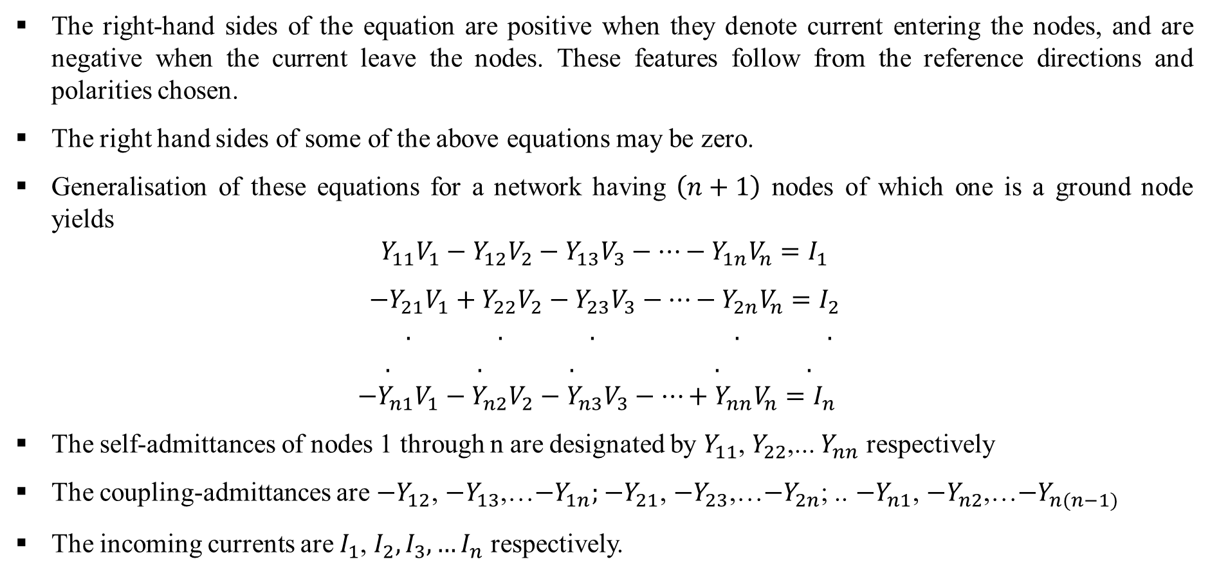
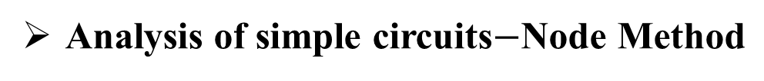
Fundamentals of Electric Circuits
Analysis of simple circuits$−\text{Node} \text{Method}$
The right-hand sides of the equation are positive when they denote current entering the nodes, and are negative when the current leave the nodes. These features follow from the reference directions and polarities chosen.
The right hand sides of some of the above equations may be zero.
Generalisation of these equations for a network having $\left(n+1\right)$ nodes of which one is a ground node yields
$$Y_{11}V_{1}−Y_{12}V_{2}−Y_{13}V_{3}−…−Y_{1n}V_{n}=I_{1}$$
$$−Y_{21}V_{1}+Y_{22}V_{2}−Y_{23}V_{3}−…−Y_{2n}V_{n}=I_{2}$$
$$. . . . .$$
$$. . . . .$$
$−Y_{n1}V_{1}−{Y_{n2}V}_{2}−{Y_{n3}V}_{3}−…+Y_{nn}V_{n}=I_{n}$
The self-admittances of nodes 1 through n are designated by $Y_{11}$, $Y_{22}$,... $Y_{nn}$ respectively
The coupling-admittances are $−Y_{12}$, $−Y_{13}$,…$−Y_{1n};$ $−Y_{21}$, $−Y_{23}$,…$−Y_{2n}$; .. $−Y_{n1}$, $−Y_{n2}$,…$−Y_{n(n−1)}$
The incoming currents are $I_{1}$, $I_{2},I_{3}, …I_{n}$ respectively.
21

Slide 28
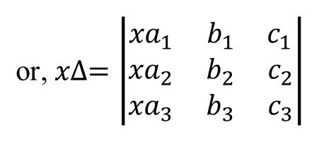
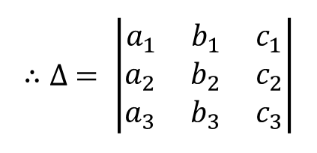
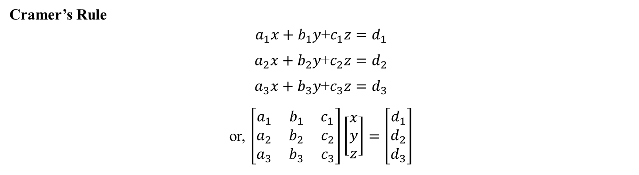
Fundamentals of Electric Circuits
Analysis of simple circuits$−\text{Node} \text{Method}$
The voltages $V_{1},$ $V_{2}$, …, $V_{n}$ can now be determined by solving the above equations by Cramer’s rule.
Cramer’s Rule
$a_{1}x+b_{1}y$+$c_{1}z=d_{1}$
$a_{2}x+b_{2}y$+$c_{2}z=d_{2}$
$a_{3}x+b_{3}y$+$c_{3}z=d_{3}$
or, $\left[\begin{aligned}a_{1} b_{1} c_{1} \\ a_{2} b_{2} c_{2} \\ a_{3} b_{3} c_{3}\end{aligned}\right]\left[\begin{aligned}x \\ y \\ z\end{aligned}\right]=\left[\begin{aligned}d_{1} \\ d_{2} \\ d_{3}\end{aligned}\right]$
$$∴∆ = \left|\begin{aligned}a_{1} b_{1} c_{1} \\ a_{2} b_{2} c_{2} \\ a_{3} b_{3} c_{3}\end{aligned}\right|$$
$$\text{or}\text{,} x∆=\left|\begin{aligned}{xa}_{1} b_{1} c_{1} \\ {xa}_{2} b_{2} c_{2} \\ {xa}_{3} b_{3} c_{3}\end{aligned}\right|$$
22

Slide 29
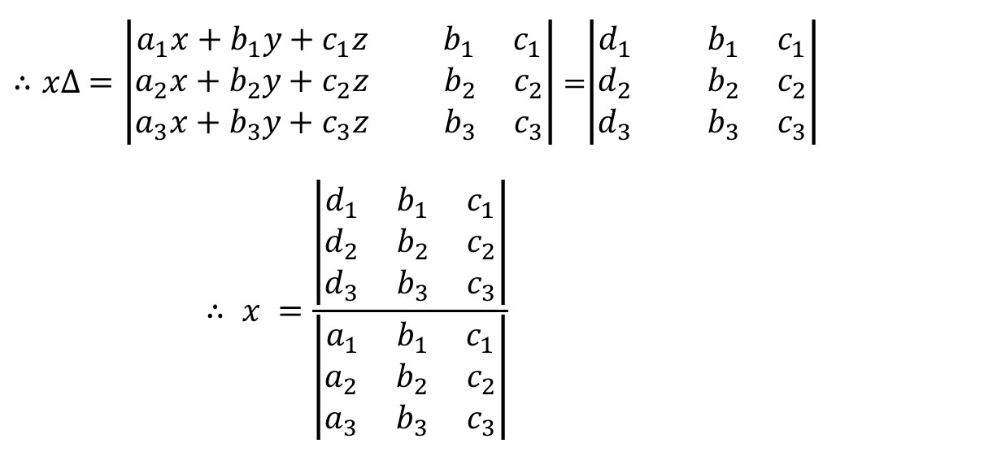
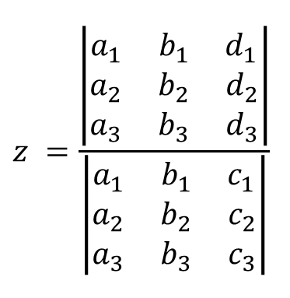
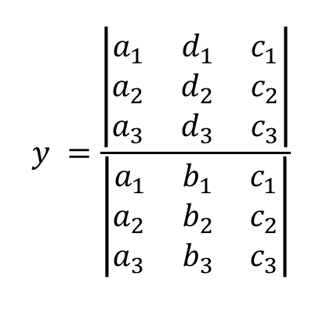
Fundamentals of Electric Circuits
Analysis of simple circuits$−\text{Node} \text{Method}$
$∴x∆ =\left|\begin{aligned}a_{1}x+b_{1}y+c_{1}z { b}_{1} c_{1} \\ a_{2}x+b_{2}y+c_{2}z b_{2} c_{2} \\ a_{3}x+b_{3}y+c_{3}z b_{3} c_{3}\end{aligned}\right|$=$\left|\begin{aligned}d_{1} { b}_{1} c_{1} \\ d_{2} b_{2} c_{2} \\ d_{3} b_{3} c_{3}\end{aligned}\right|$
$$∴ x =\frac{\left|\begin{aligned}d_{1} b_{1} c_{1} \\ d_{2} b_{2} c_{2} \\ d_{3} b_{3} c_{3}\end{aligned}\right|}{\left|\begin{aligned}a_{1} b_{1} c_{1} \\ a_{2} b_{2} c_{2} \\ a_{3} b_{3} c_{3}\end{aligned}\right|}$$
$$y =\frac{\left|\begin{aligned}a_{1} d_{1} c_{1} \\ a_{2} d_{2} c_{2} \\ a_{3} d_{3} c_{3}\end{aligned}\right|}{\left|\begin{aligned}a_{1} b_{1} c_{1} \\ a_{2} b_{2} c_{2} \\ a_{3} b_{3} c_{3}\end{aligned}\right|}$$
$$z =\frac{\left|\begin{aligned}a_{1} b_{1} d_{1} \\ a_{2} b_{2} d_{2} \\ a_{3} b_{3} d_{3}\end{aligned}\right|}{\left|\begin{aligned}a_{1} b_{1} c_{1} \\ a_{2} b_{2} c_{2} \\ a_{3} b_{3} c_{3}\end{aligned}\right|}$$
Similarly,
and
23

Slide 30
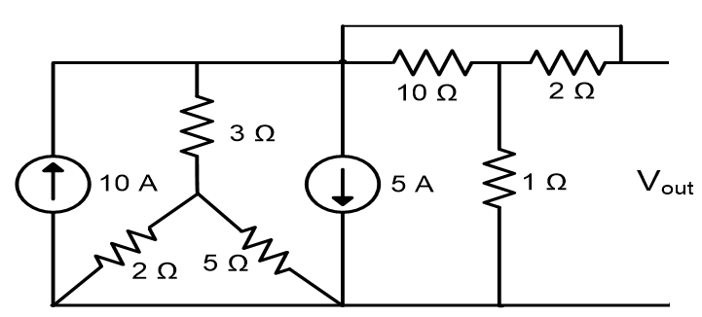
Fundamentals of Electric Circuits
Analysis of simple circuits$−\text{Node} \text{Method}$
Example – P1.2
Determine the output voltage, $V_{out}$ in the circuit as shown in Fig. P1.2 by using nodal method.
Fig. P1.2
24

Slide 31
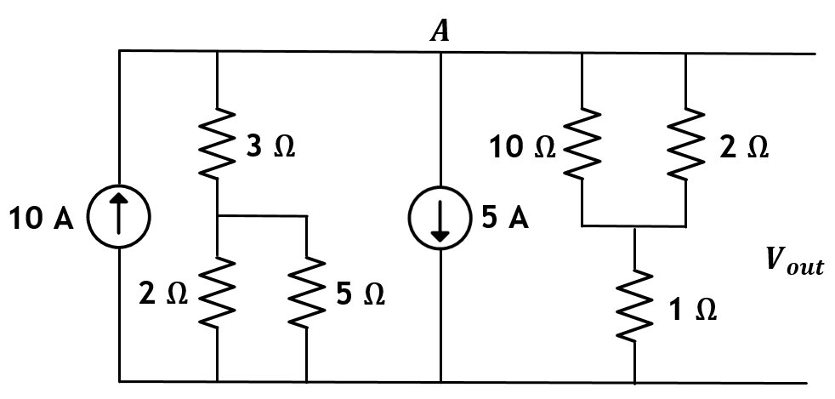
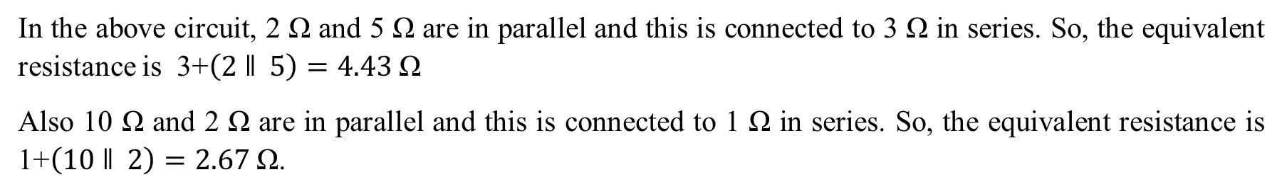
Fundamentals of Electric Circuits
Analysis of simple circuits$−\text{Node} \text{Method}$
Solution of Example – P1.2
Fig. P1.2
In the above circuit, 2 Ω and 5 Ω are in parallel and this is connected to 3 Ω in series. So, the equivalent resistance is 3+$\left(2 ǁ 5\right)=4.43 \text{Ω}$
Also 10 Ω and 2 Ω are in parallel and this is connected to 1 Ω in series. So, the equivalent resistance is 1+$\left(10 ǁ 2\right)=2.67 \text{Ω}$.
25

Slide 32
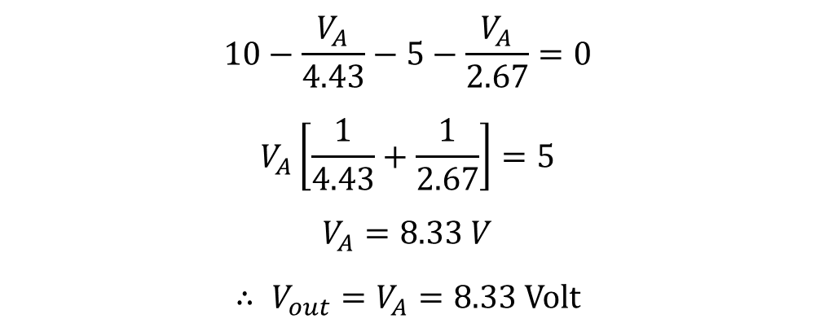
Fundamentals of Electric Circuits
Analysis of simple circuits$−\text{Node} \text{Method}$
Solution of Example – P1.2
Assuming voltage $V_{A}$ at node $A$and applying Kirchhoff’s current law in the circuit, we get
$$10−\frac{V_{A}}{4.43}−5−\frac{V_{A}}{2.67}=0$$
$$V_{A}\left[\frac{1}{4.43}+\frac{1}{2.67}\right]=5$$
$$V_{A}=8.33 V$$
$∴ V_{out}=V_{A}=8.33$Volt
26

Slide 33
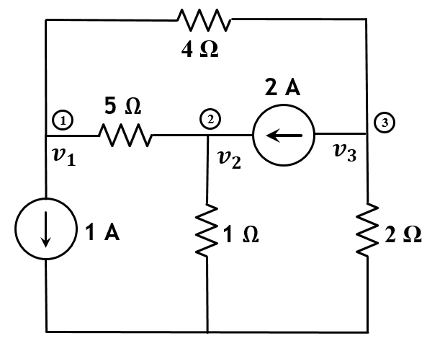
Fundamentals of Electric Circuits
Analysis of simple circuits$−\text{Node} \text{Method}$
Example – P1.3
In the network of Fig. P1.3, find the current through and voltage across 5 Ω resistor.
Fig. P1.3
27

Slide 34

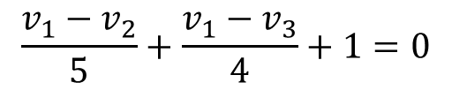
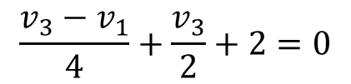

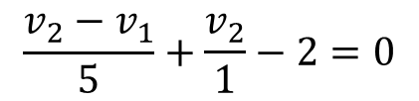

Fundamentals of Electric Circuits
Analysis of simple circuits$−\text{Node} \text{Method}$
Solution of Example – P1.3
Apply KCL at node 1 and we get
$$\frac{v_{1}−v_{2}}{5}+\frac{v_{1}−v_{3}}{4}+1=0$$
or,
$$9v_{1}−4v_{2}−5v_{3}=−20$$
1
Apply KCL at node 2 and we get
$$\frac{v_{2}−v_{1}}{5}+\frac{v_{2}}{1}−2=0$$
or,
$${−v}_{1}+6v_{2}=10$$
2
Apply KCL at node 3 and we get
$$\frac{v_{3}−v_{1}}{4}+\frac{v_{3}}{2}+2=0$$
or,
$${−v}_{1}+3v_{3}=−8$$
3
28

Slide 35
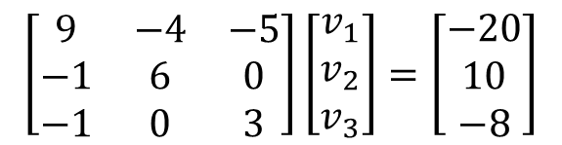
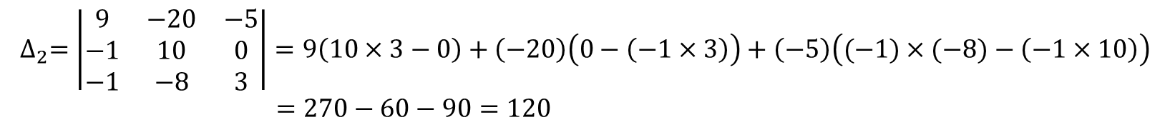
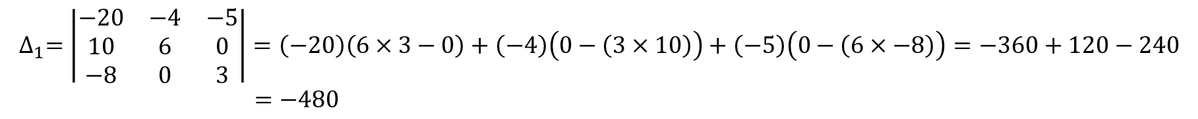
Fundamentals of Electric Circuits
Analysis of simple circuits$−\text{Node} \text{Method}$
Solution of Example – P1.3
In matrix form,
$$\left[\begin{matrix}9 & −4 & −5 \\ −1 & 6 & 0 \\ −1 & 0 & 3\end{matrix}\right]\left[\begin{matrix}v_{1} \\ v_{2} \\ v_{3}\end{matrix}\right]=\left[\begin{matrix}−20 \\ 10 \\ −8\end{matrix}\right]$$
$$∆=\left|\begin{matrix}9 & −4 & −5 \\ −1 & 6 & 0 \\ −1 & 0 & 3\end{matrix}\right|=9\left(6×3−0\right)+\left(−4\right)\left(0−\left(−1×3\right)\right)+\left(−5\right)\left(0−\left(−1×6\right)\right)=162−12−30=120$$
$$∆_{1}=\left|\begin{matrix}−20 & −4 & −5 \\ 10 & 6 & 0 \\ −8 & 0 & 3\end{matrix}\right|=\left(−20\right)\left(6×3−0\right)+\left(−4\right)\left(0−\left(3×10\right)\right)+\left(−5\right)\left(0−\left(6×−8\right)\right)=−360+120−240$$
$=−480$
$$∆_{2}=\left|\begin{matrix}9 & −20 & −5 \\ −1 & 10 & 0 \\ −1 & −8 & 3\end{matrix}\right|=9\left(10×3−0\right)+\left(−20\right)\left(0−\left(−1×3\right)\right)+\left(−5\right)\left((−1)×(−8)−\left(−1×10\right)\right)$$
$=270−60−90=120$
29

Slide 36







Fundamentals of Electric Circuits
Analysis of simple circuits$−\text{Node} \text{Method}$
Solution of Example – P1.3
$$∴$$
$$v_{1}=\frac{∆_{1}}{∆}=\frac{−480}{120}=−4 V$$
$$v_{2}=\frac{∆_{2}}{∆}=\frac{120}{120}=1 V$$
$$;$$
$$∴$$
The current through 5 Ω resistor is
$$\frac{v_{1}−v_{2}}{5}=\frac{−4−1}{5}=−1 A$$
$$∴$$
The voltage drop across 5 Ω resistor is $\left(v_{1}−v_{2}\right)=−5 V$.
30

Slide 37




Fundamentals of Electric Circuits
Analysis of simple circuits$−\text{Mesh} \text{Method}$
The analysis of mesh method is illustrated through the circuit as shown in Fig. 1.8.
The current supplied by the generator of voltage $V_{a}$ is to find out.
A suitable tree as shown in Fig. 1.9 is selected in such a way that the links of the tree contain the generator $V_{a}$, the impedance $Z_{5}$, and the impedance $Z_{6}$.
Fig. 1.8. Circuit used for mesh analysis
Fig. 1.9. A tree of the circuit of Fig. 1.8
31

Slide 38

Fundamentals of Electric Circuits
Analysis of simple circuits$−\text{Mesh} \text{Method}$
The network contains six branches and four nodes marked $p$, $q$, $c$ and $o$.
The number of links or independent meshes is ($b−n+1)=(6−4+1)=3$.
These three links placed one at a time, form the meshes $pcorp, osqco$and $pqcp$ respectively.
The link currents or the mesh currents in Fig. 1.8 are denoted by $I_{1}$, $I_{2}$ and $I_{3}$ respectively.
Kirchhoff’s voltage law equation is to be written for each mesh. These equations are called mesh equations or loop equations.
These equations are to be solved to yield the link currents or the mesh currents.
The current in a tree branch which is common to two or more meshes is obtained by algebraically summing the associated mesh currents.
32

Slide 39


Fundamentals of Electric Circuits
Analysis of simple circuits$−\text{Mesh} \text{Method}$
Application of Kirchhoff’s Voltage Law to the three meshes gives the following three simultaneous equations.
$$\left.Z_{1} I_{1}+Z_{2} \left(I_{1}−I_{3}\right)+Z_{3 }\left(I_{1}+I_{2}\right)=V_{b}+V_{a}=V_{1} (say\right)$$
(1)
$$\left.{Z_{3} \left(I_{2}+I_{1}\right)+Z_{4 }\left(I_{2}+I_{3}\right)+Z}_{5}{ I}_{2}=V_{b}=V_{2} (say\right)$$
(2)
$${Z_{2} \left(I_{3}−I_{1}\right)+Z_{4 }\left(I_{3}+I_{2}\right)+Z}_{6}{ I}_{3}=0$$
(3)
Rearranging equations (1) through (3), we obtain
$$\left(Z_{1}+Z_{2}+Z_{3}\right) I_{1}+Z_{3} I_{2}−Z_{2 }I_{3}=V_{1}$$
(4)
$$Z_{3} I_{1}+\left(Z_{3}+Z_{4}+Z_{5}\right) I_{2}+Z_{4 }I_{3}=V_{2}$$
(5)
Fig. 1.8. Circuit used for mesh analysis
$${−Z}_{2} I_{1}+Z_{4 }I_{2}+\left(Z_{2}+Z_{4}+Z_{6}\right) I_{3}=0$$
(6)
33

Slide 40

Fundamentals of Electric Circuits
Analysis of simple circuits$−\text{Mesh} \text{Method}$
Solving these equations, we get the desired current $I_{1}$. The solution for $I_{2}$ and $I_{3}$ give the currents in impedances $Z_{5}$ and $Z_{6}$ respectively.
The current through $Z_{2}$ is $\left(I_{1}−I_{3}\right)$, that through $Z_{4 }$is $\left(I_{2}+I_{3}\right)$ and that through $Z_{3}$is $\left(I_{1}+I_{2}\right)$.
If any current turns out to be negative, it simply means that its actual reference direction is opposite to that chosen.
Since the current through any impedance is known, the voltages at the nodes are readily determined.
The sum of the impedances in going completely round a mesh is referred to as the self-impedance of the mesh.
The self-impedances of meshes 1 through $n$are denoted by $Z_{11}$, $Z_{22}$, $Z_{33}$, …, $Z_{nn}$ respectively.
In the example, $Z_{11}=\left(Z_{1}+Z_{2}+Z_{3}\right)$, $Z_{22}=\left(Z_{3}+Z_{4}+Z_{5}\right)$ and $Z_{33}=\left(Z_{2}+Z_{4}+Z_{6}\right).$
The impedances that is common to two meshes is called the coupling impedance between the meshes.
The coupling impedance between meshes $h$ and $k$ is denoted by $Z_{hk}$
34

Slide 41

Fundamentals of Electric Circuits
Analysis of simple circuits$−\text{Mesh} \text{Method}$
The coupling impedance between meshes $h$ and $k$ is denoted by $Z_{hk}$.
Since, only linear bilateral elements are considered, hence $Z_{hk}=Z_{kh}(k≠h)$.
In the example, $Z_{12}=Z_{21}=Z_{3}$, $Z_{13}=Z_{31}=Z_{2}$and $Z_{23}=Z_{32}=Z_{4}.$
Generalisation of these equations for a network having $n$ meshes yields.
$$Z_{11}I_{1}+Z_{12}I_{2}+Z_{13}I_{3}+…+Z_{1n}I_{n}=V_{1}$$
$$Z_{21}I_{1}+Z_{22}I_{2}+Z_{23}I_{3}+…+Z_{2n}I_{n}=V_{2}$$
$$. . . . .$$
$$. . . . .$$
$$. . . . .$$
$Z_{n1}I_{1}+{Z_{n2}I}_{2}+{Z_{n3}I}_{3}+…+Z_{nn}I_{n}=V_{n}$
Here, the signs of the self-impedance terms are all positive.
The signs of some of the coupling impedance terms may be negative depending on the chosen reference directions of currents.
35

Slide 42

Fundamentals of Electric Circuits
Analysis of simple circuits$−\text{Mesh} \text{Method}$
The coupling impedance between meshes $h$ and $k$ is denoted by $Z_{hk}$.
The sign before $Z_{hk}$ will be positive if the currents in the adjacent meshes $h$ and $k$ flow in the same direction through$Z_{hk}$.
If they flow in the opposite direction through${ Z}_{hk}$, the sign before $Z_{hk}$ is negative.
If there is no impedance common to meshes $h$ and $k$, $Z_{hk}=Z_{kh}$ will be zero.
$V_{1}$, $V_{2}$,…..$V_{n}$ are respectively the resultant voltages applied to meshes 1, 2,…n. If there is no resultant applied voltage in a particular, say $h$, $V_{h}$will be zero.
The currents $I_{1},$ $I_{2}$, …, $I_{n}$ can now be determined by solving the above equations by Cramer’s rule.
36

Slide 43

Fundamentals of Electric Circuits
Analysis of simple circuits$−\text{Mesh} \text{Method}$
Example – P1.4
Find the current in the 3 Ω resistor of the circuit as shown in Fig. P1.4 by mesh method
Fig. P1.4
37

Slide 44

Fundamentals of Electric Circuits
Analysis of simple circuits$−\text{Mesh} \text{Method}$
Solution of Example – P1.4
Fig. P1.4.1
The current through 3 Ω resistor is given by $I_{L}=0.806 A$
38

Slide 45
LECTURE 3

Slide 46


Fundamentals of Electric Circuits
$\text{Delta}\text{/}\text{Star} \text{and} \text{Star}\text{/}\text{Delta} \text{Transformation}$
The complicated networks can be simplified by successfully replacing delta meshes by equivalent star systems and vice versa.
The analysis of ‘delta/star and star/delta transformation’ is illustrated through the circuit as shown in Fig. 1.9.
(a)
(b)
Fig. 1.9. Circuit for delta/star and star/delta transformation
39

Slide 47

Fundamentals of Electric Circuits
$\text{Delta}\text{/}\text{Star} \text{and} \text{Star}\text{/}\text{Delta} \text{Transformation}$
Three resistances$R_{12}$, $R_{23}$ and $R_{31}$ are connected in delta fashion between terminals 1, 2 and 3 as shown in Fig. 12 (a).
These three resistances are replaced by the resistances${ R}_{1}$, $R_{2}$ and $R_{3}$, connected in star as shown in Fig. 12(b).
These two arrangements will be electrically equivalent if the resistance as measured between any pair of terminals is the same in both the arrangements.
First, consider the terminals of 1 and 2 in delta connection. There are two parallel paths. One having a resistance of $R_{12}$ and the other having a resistance$of \left(R_{23}+R_{31}\right)$.
$∴$ Resistance between terminals 1 and 2 is
$$\frac{R_{12}×\left(R_{23}+R_{31}\right)}{R_{12}+R_{23}+R_{31}}$$
Now, consider star connection. The resistance between the same terminals 1 and 2 is $\left(R_{1}+R_{2}\right).$
40

Slide 48



Fundamentals of Electric Circuits
$\text{Delta}\text{/}\text{Star} \text{and} \text{Star}\text{/}\text{Delta} \text{Transformation}$
As terminal resistance have to be the same
$$R_{1}+R_{2}=\frac{R_{12}\left(R_{23}+R_{31}\right)}{R_{12}+R_{23}+R_{31}}$$
(1)
Similarly, for terminals 2 and 3 and terminals 3 and 1, we get
$$R_{2}+R_{3}=\frac{R_{23}\left(R_{31}+R_{12}\right)}{R_{12}+R_{23}+R_{31}}$$
(2)
$$R_{3}+R_{1}=\frac{R_{31}\left(R_{12}+R_{23}\right)}{R_{12}+R_{23}+R_{31}}$$
and
(3)
41

Slide 49



Fundamentals of Electric Circuits
$\text{Delta}\text{/}\text{Star} \text{and} \text{Star}\text{/}\text{Delta} \text{Transformation}$
Now, subtracting (2) from (1) and adding the result to (3), we get
$$R_{1}=\frac{R_{12}R_{31}}{R_{12}+R_{23}+R_{31}}$$
(4)
Putting the value of $R_{1}$ in Eq. (1), we get
$$R_{2}=\frac{R_{23}R_{12}}{R_{12}+R_{23}+R_{31}}$$
(5)
Putting the value of $R_{1}$ in Eq. (3), we get
$$R_{3}=\frac{R_{31}R_{23}}{R_{12}+R_{23}+R_{31}}$$
(6)
So, resistance of each arm of the star is given by the product of the resistances of the two delta sides that meet at its end divided by the sum of the three delta resistances.
42

Slide 50



Fundamentals of Electric Circuits
$\text{Delta}\text{/}\text{Star} \text{and} \text{Star}\text{/}\text{Delta} \text{Transformation}$
Dividing Eq. (4) by Eq. (5), we get
$$\frac{R_{1}}{R_{2}}=\frac{R_{31}}{R_{23}}$$
(7)
Similarly, dividing Eq. (5) by Eq. (6), we get
$$\frac{R_{2}}{R_{3}}=\frac{R_{12}}{R_{31}}$$
(8)
From Eqs. (7) and (8), we get
$$R_{23}=\frac{R_{2}}{R_{1}}R_{31} \text{and} R_{12}=\frac{R_{2}}{R_{3}}R_{31}$$
43

Slide 51

Fundamentals of Electric Circuits
$\text{Delta}\text{/}\text{Star} \text{and} \text{Star}\text{/}\text{Delta} \text{Transformation}$
Putting values of $R_{23}$ and $R_{12}$ in Eq. (1), we get
$$R_{1}+R_{2}=\frac{R_{12}\left(R_{23}+R_{31}\right)}{R_{12}+R_{23}+R_{31}}$$
$$=\frac{\frac{R_{2}}{R_{3}}R_{31}\left(\frac{R_{2}}{R_{1}}R_{31}+R_{31}\right)}{\frac{R_{2}}{R_{3}}R_{31}+\frac{R_{2}}{R_{1}}R_{31}+R_{31}}$$
$$=\frac{\frac{R_{2}}{R_{3}}R_{31}\left(1+\frac{R_{2}}{R_{1}}\right)R_{31}}{R_{31}\left(1+\frac{R_{2}}{R_{3}}+\frac{R_{2}}{R_{1}}\right)}$$
44

Slide 52





Fundamentals of Electric Circuits
$\text{Delta}\text{/}\text{Star} \text{and} \text{Star}\text{/}\text{Delta} \text{Transformation}$
$${ R}_{1}+R_{2} =\frac{\left(R_{1}+R_{2}\right)R_{2}R_{31}}{R_{1}R_{3}}×\frac{R_{1}R_{3}}{{R_{1}R_{2}+R}_{2}R_{3}+R_{3}R_{1}}$$
$$R_{31}=\frac{{R_{1}R_{2}+R}_{2}R_{3}+R_{3}R_{1}}{R_{2}}$$
or,
or,
$${ R}_{31}=R_{3}+R_{1}+\frac{R_{3}R_{1}}{R_{2}}$$
$$∴$$
Similarly,
$$R_{23}=R_{2}+R_{3}+\frac{R_{2}R_{3}}{R_{1}}$$
$$R_{12}=R_{1}+R_{2}+\frac{R_{1}R_{2}}{R_{3}}$$
45

Slide 53
Fundamentals of Electric Circuits
$\text{Delta}\text{/}\text{Star} \text{and} \text{Star}\text{/}\text{Delta} \text{Transformation}$
Example – P1.5
Determine the equivalent resistance across X-Y of the circuit as shown in Fig. P1.5 by using star-delta transformation.
46

Slide 54







Fundamentals of Electric Circuits
$\text{Delta}\text{/}\text{Star} \text{and} \text{Star}\text{/}\text{Delta} \text{Transformation}$
Solution of Example – P1.5
There are two star circuits in Fig. P1.5. One consisting of 5 Ω, 3 Ω and 4 Ω resistors and other one consisting of 6 Ω, 4 Ω and 8 Ω resistors.
Convert the star circuits into delta circuits so that the two delta circuits are in parallel.
The two star circuits and their equivalent circuits are shown below:
$$R_{1}=\frac{5×3+4×3+5×4}{4}=11.75$$
Ω
$$R_{2}=\frac{5×3+4×3+5×4}{3}=15.67$$
Ω
$$\left(a\right)$$
$$\left(b\right)$$
$$R_{3}=\frac{5×3+4×3+5×4}{5}=9.4$$
Ω
Fig. P1.5.1
47

Slide 55







Fundamentals of Electric Circuits
$\text{Delta}\text{/}\text{Star} \text{and} \text{Star}\text{/}\text{Delta} \text{Transformation}$
Solution of Example – P1.5
The two star circuits and their equivalent circuits are shown below:
$$\left(a\right)$$
$$\left(b\right)$$
Fig. P1.5.2
$$R_{1}^{′}=\frac{6×4+4×8+8×6}{8}=13$$
$$R_{2}^{′}=\frac{6×4+4×8+8×6}{4}=26$$
Ω
Ω
$$R_{3}^{′}=\frac{6×4+4×8+8×6}{6}=17.3$$
Ω
48

Slide 56



Fundamentals of Electric Circuits
$\text{Delta}\text{/}\text{Star} \text{and} \text{Star}\text{/}\text{Delta} \text{Transformation}$
Solution of Example – P1.5
The simplified circuit is shown in figure below
In the circuit, three resistors 10 Ω, 9.4 Ω and 17.3 Ω are in parallel.
Equivalent resistance = (10 ǁ 9.4 ǁ 17.3) = 3.78 Ω.
Resistors 13 Ω and 11.75 Ω are in parallel.
Equivalent resistance = (13 ǁ 11.75) = 6.17 Ω.
Resistors 26 Ω and 15.67 Ω are in parallel.
Equivalent resistance = (26 ǁ 15.67) = 9.78 Ω.
The simplified circuit is shown in Fig. below
$∴$ The equivalent resistance $R_{eq}=\left(9.78 ǁ \left(6.17+5.78\right)\right)$
$=\left(9.78 ǁ 9.95\right)=4.93 Ω$
49

Slide 57
LECTURE 4

Slide 58
Fundamentals of Electric Circuits
Sources
Definition: The availability of electrical energy with network components called sources.
Example: Generators or alternators, that convert mechanical energy into electrical energy.
A battery that convert chemical energy into electrical energy.
Sources
Independent Sources
Dependent Sources
1. Independent Voltage Source
1. Voltage- Controlled Voltage Source (VCVS)
2. Independent Current Source
2. Voltage- Controlled Current Source (VCVS)
3. Current- Controlled Voltage Source (CCVS)
4. Current- Controlled Current Source (CCCS)
50

Slide 59


Fundamentals of Electric Circuits
Sources
Independent Source: The sources which do not depend on any other quantity in the circuit are called independent sources.
Independent Voltage Source
A practical energy source such as battery in an automobile can maintain a voltage across its terminals which is relatively independent of the current required by the accessories under practical operating conditions.
The idealization of the device with a network component called an independent voltage source or more simply a voltage source.
The network symbol for the representation of an independent voltage source is shown in Fig. 1.10.
The $(+)$ and $(−)$ marks inside the circle of the voltage source symbol identify the component as a voltage source.
Fig. 1.10. Independent Voltage Source
51

Slide 60


Fundamentals of Electric Circuits
Sources
Independent Source
Independent Voltage Source
Independent voltage source equation or source equation is $V_{ab}=V(t)$
The component equation is graphically depicted in Fig. 1.11 for an independent voltage source with voltage $V_{ab}=12 V$ to emphasize that the terminal voltage is independent of the terminal current.
It is observed from Fig. 1.11 that current $i_{ab}$ has no effect on voltage $V_{ab}.$
Fig. 1.11. Graphical representation of Independent Voltage Source
52

Slide 61

Fundamentals of Electric Circuits
Sources
Independent Source
Independent Voltage Source
Definition: An independent voltage source is a two terminal network component with terminal voltage $V_{ab}$ specified by a time function $v(t)$ that is independent of the terminal current$i_{ab}$.
The definition of a voltage source represent that a short circuit can be considered to be a voltage source of value zero.
An independent voltage source can also be known as an ideal voltage source.
53

Slide 62

Fundamentals of Electric Circuits
Sources
Independent Source
Independent Current Source
A few practical devices generate a current that is relatively independent of the terminal voltage over the normal range of operating voltage. The examples are as follows:
A constant current transformer used to supply power to incandescent street light.
An automobile alternator which provides relatively constant current under certain operating conditions.
We idealize such a device with a network component called an independent current source, or more simply a current source.
The network symbol used to represent an independent current source is shown in Fig. 1.12.
The arrow inside the circle of the current source symbol identifies the component as a current source.
Fig. 1.12. Independent Current Source
54

Slide 63


Fundamentals of Electric Circuits
Sources
Independent Source
Independent Current Source
An Independent current source equation or source equation is $i_{ab}=i(t)$
The component equation is graphically depicted in Fig. 1.13 for an independent current source with current $i_{ab}=50 A$ to emphasize that the terminal current is independent of the terminal voltage.
It is observed from Fig. 1.13 that voltage $V_{ab}$ has no effect on current $i_{ab}.$
Fig. 1.13. Graphical representation of Independent Current Source
55

Slide 64

Fundamentals of Electric Circuits
Sources
Independent Source
Independent Current Source
Definition: An independent current source is a two terminal network component with terminal current $i_{ab}$ specified by a time function $i(t)$ that is independent of the terminal voltage $V_{ab}$.
The definition of a current source represent that an open circuit can be considered to be a current source of value zero
An independent current source can also be known as an ideal current source.
56

Slide 65
Fundamentals of Electric Circuits
Sources
Dependent Source
Many electrical systems take a small amount of electric power from one source and use this to control the delivery of a large amount of electric power from another source.
The example of dependent source is an amplifier used in a tape player. The working principle of the amplifier is given below:
The magnetized tape moving past the tape ahead, which consists of magnetic material and a small coil of wire, generates a very small voltage signal that delivers a small fraction of a watt to the amplifier.
This low power signal ultimately controls the delivery of tens of watts to the speaker system.
The power to the speaker is obtained from the amplifier power source: a car battery or an electrical outlet.
The ability to control the delivery of power is modelled by the introduction of four terminal network components called dependent sources or controlled sources.
57

Slide 66


Fundamentals of Electric Circuits
Sources
Dependent Source
Voltage- Controlled Voltage Source (VCVS)
A tape player amplifier is an example of voltage-controlled voltage source. The amplifier generate a large voltage across two terminals that is intended to be proportional to a smaller voltage established across other two terminals.
A practical voltage amplifier is idealized with a four terminal network component called a voltage controlled voltage source (VCVS).
The network symbol as shown in Fig. 1.14 is used to represent a VCVS.
The $\left(+\right)$ and $\left(–\right)$ marks inside the diamond of the component symbol identify the component as a voltage source.
Fig. 1.14. Voltage- Controlled Voltage Source
58

Slide 67

Fundamentals of Electric Circuits
Sources
Dependent Source
Voltage- Controlled Voltage Source (VCVS)
An equivalent definition is given by the following component equation or control equation.
Control Equation: $V_{cd}=μV_{ab}$
It is observed that voltage $V_{cd}$depends only on the constant $μ$, a dimensionless constant called the voltage gain and the control voltage $V_{ab}$.
Current $i_{cd}$ can affect voltage $V_{cd}$ only if it affects $V_{ab}$voltage.
Definition: A voltage controlled voltage source is a four-terminal network component that establishes a voltage $V_{cd}$ between two points $c$ and $d$in the circuit that is proportional to a voltage $V_{ab}$ between two points $a$ and $b$.
59

Slide 68



Fundamentals of Electric Circuits
Sources
Dependent Source
Voltage- Controlled Voltage Source (VCVS)
Example of VCVS
Determine voltage $V_{2}$ in the circuit as shown in Fig. 1.15
Fig. 1.15. Test figure of Voltage- Controlled Voltage Source
Solution for Example of VCVS
Kirchhoff’s voltage law easily established that $V_{1}=12 V$
$$∴ V_{2}=5 V_{1}=5×12 V=60 V$$
60

Slide 69

Fundamentals of Electric Circuits
Sources
Dependent Source
Voltage- Controlled Current Source (VCCS)
The field-effect transistor is an example of voltage-controlled current source. This electronic device permit the control of a current directly with a voltage.
The device is idealized with a four terminal network component called a voltage-controlled current source (VCCS).
The network symbol as shown in Fig. 1.16 is used to represent a VCCS.
The arrow inside the diamond of the component symbol identifies the component as a current source.
Fig. 1.16. Voltage- Controlled Current Source
61

Slide 70

Fundamentals of Electric Circuits
Sources
Dependent Source
Voltage- Controlled Current Source (VCCS)
An equivalent definition is given by the following component equation or control equation.
Control Equation: $i_{cd}=g_{m}V_{ab}$
It is observed that current $i_{cd}$ depends only on the control voltage $V_{ab}$ and the constant $g_{m}$, called the transconductance or mutual conductance.
Constant $g_{m}$ has dimension of ampere per volt or Siemens (S).
Definition: A voltage-controlled current source is a four-terminal network component that establishes a current $i_{cd}$ in a branch of the circuit that is proportional to the voltage $V_{ab}$ between two points $a$ and $b$.
62

Slide 71



Fundamentals of Electric Circuits
Sources
Dependent Source
Voltage- Controlled Current Source (VCCS)
Example of VCCS
Determine the current $i_{x}$ in the circuit as shown in Fig. 1.17
Fig. 1.17. Test figure of Voltage- Controlled Current Source
Solution for Example of VCCS
$$V_{1}=6−2=4 V$$
$$∴i_{x}=−10V_{1}=−\left(10×4\right)=−40 A$$
63

Slide 72


Fundamentals of Electric Circuits
Sources
Dependent Source
Current- Controlled Voltage Source (CCVS)
The resistor is an example of current-controlled voltage source. This device permits the control of voltage across one branch with current through another branch in the circuit.
The device is idealized with a four terminal network component called a current-controlled voltage source (CCVS).
The network symbol as shown in Fig. 1.18 is used to represent a CCVS.
The $\left(+\right)$ and $\left(–\right)$ marks inside the diamond of the component symbol identify the component as a voltage source.
Fig. 1.18. Current- Controlled Voltage Source
64

Slide 73

Fundamentals of Electric Circuits
Sources
Dependent Source
Current-Controlled Voltage Source (VCCS)
An equivalent definition is given by the following component equation or control equation.
Control Equation:${ V}_{cd}=r i_{ab}$
It is observed that voltage $V_{cd}$depends only on the control current $i_{ab}$ and the constant$r$, called the transresistance or mutual resistance.
Constant $r$ has the dimension of volt per ampere or ohm (Ω).
Definition: A current-controlled voltage source is a four-terminal network component that establishes a voltage $V_{cd}$ between two points $c$ and $d$ in the circuit that is proportional to current $i_{ab}$ in some branch of the circuit.
65

Slide 74



Fundamentals of Electric Circuits
Sources
Dependent Source
Current- Controlled Voltage Source (CCVS)
Example of CCVS
Determine voltage $V_{2}$ in the circuit as shown in Fig. 1.19.
Fig. 1.19. Test figure of Current-Controlled Voltage Source
Solution for Example of CCVS
$$i_{1}=15 A$$
$$∴V_{2}=6 i_{1}=\left(6×15\right) V=90 V$$
66

Slide 75

Fundamentals of Electric Circuits
Sources
Dependent Source
Current- Controlled Current Source (CCCS)
The bipolar junction transistor is an example of current-controlled current source. This device permits the control of one current with another
The device is idealized with a four terminal network component called a current-controlled current source (CCCS).
The network symbol as shown in Fig. 1.20 is used to represent a CCCS.
The arrow inside the diamond of the component equation identifies the component as a current source.
Fig. 1.20. Current- Controlled Current Source
67

Slide 76

Fundamentals of Electric Circuits
Sources
Dependent Source
Current-Controlled Current Source (CCCS)
An equivalent definition is given by the following component equation or control equation.
Control Equation:$i_{cd}=β i_{ab}$
It is observed that current $i_{cd}$ depends only on the control current $i_{ab}$ and the dimensionless $β$, called the current gain.
Definition: A current-controlled current source is a four-terminal network component that establishes a current $i_{cd}$ in one branch of a circuit that is proportional to current $i_{ab}$ in some branch of the network.
68

Slide 77



Fundamentals of Electric Circuits
Sources
Dependent Source
Current- Controlled Current Source (CCCS)
Example of CCCS
Determine current $i_{2}$ in the circuit as shown in Fig. 1.21.
Fig. 1.21. Test figure of Current-Controlled Current Source
Solution for Example of CCCS
$$i_{1}=10 A$$
$$∴i_{2}=5+7i_{1}=5+\left(7×10\right) A=75 A$$
69

Slide 78


Fundamentals of Electric Circuits
Equivalence of voltage and current sources
The equivalence of voltage and current sources is shown in Fig. 1.22.
(a)
(b)
Fig. 1.22. Equivalence of Voltage and Current Sources
In Fig. 1.22(a), a voltage source, $V$ in series with an impedance, $Z_{g}$ supplies a current $I$ to a load impedance $Z.$
$Z_{g}$ represent the internal impedance of the source.
70

Slide 79



Fundamentals of Electric Circuits
Equivalence of voltage and current sources
The phasor equation for the load voltage is
$$V_{0}=V−IZ_{g}$$
(1)
$$∴ I=\frac{V}{Z_{g}}−\frac{V_{0}}{Z_{g}}=VY_{g}−V_{0}Y_{g}$$
(2)
where $Y_{g}=1/{Z_{g}}$.
The circuit in Fig. 1.22(b) represents Eq. (2). Here, $VY_{g}$ is the current delivered by the voltage source when the terminals ab are short-circuited.
The circuits shown in Fig. 1.22(a) & (b) are equivalent so far as the current through the load impedance $Z$ is concerned.
The mutual conversion of voltage & current sources is positive when $Z_{g}$ is finite other than zero.
71

Slide 80

Fundamentals of Electric Circuits
Equivalence of voltage and current sources
Example – P1.6
Determine$i_{1}$, $v_{1}$, $i_{x}$, $v_{x}$ and $v_{ab}$ for the network as shown in Fig. P1.6, if no other components are connected to terminals $a$ and $b$.
Fig. P1.6
72

Slide 81

Fundamentals of Electric Circuits
Equivalence of voltage and current sources
Solution of Example – P1.6
$$i_{1}=5 A$$
${ v}_{1}=30−50$=$−20 V$
$$i_{x}=2i_{1}=2×5 A=10 A$$
$$v_{x}=v_{1}−40+5v_{1}=\left(−20−40−100\right)V=−160 V$$
$$v_{ab}=\left(−20\right)−5v_{1}+40=\left(−20+100+40\right)V=120 V$$
Independent and Dependent Sources are active components.
The source which cannot supply positive average power, these are passive components.
A network that contains one or more active components is an active network.
A passive network contains only passive components.
Some physical devices convert electrical energy into heat or store energy in electric or magnetic fields. We model the properties of the devices with network components called elements.
73

Slide 82

Fundamentals of Electric Circuits
Equivalence of voltage and current sources
Example – P1.7
Find $i$ in the circuit of Fig. P1.7. Check the power balance condition.
Fig. P1.7
74

Slide 83


Fundamentals of Electric Circuits
Equivalence of voltage and current sources
Solution of Example – P1.7
Applying KVL in the given loop
$$10 V_{0}−6+V_{0}−10+100 i=0$$
$$11 V_{0}−16+100 i=0$$
$$100 i=16−11 V_{0}$$
$100 i=16−11\left(10 i \right) \left[∵ V_{0}=10 i \right]$
$$100 i=16−110 i$$
$$∴ i=\frac{16}{210}=76.2 mA$$
The dependent source offers a terminal voltage of $10 V_{0}$ = $10 \left(10 i\right)=7.62 V$
In the circuit, power is supplied by 6 V and 10 V source while power is absorbed by 110 $Ω$resistor (dissipating heat) and the dependent source.
75

Slide 84

Fundamentals of Electric Circuits
Equivalence of voltage and current sources
Solution of Example – P1.7
Thus power supplied by 6 V source $=6×0.0762 W=0.4572 W$
Power supplied by 10 V source $=10×0.0762 W=0.762 W$
$∴$ Total power supplied $=\left(0.4572+0.762\right)W=1.219 W≈1.22 W$
Power absorbed by the dependent source is $\left(7.62×0.0762\right)W=0.5806 W$ and
power absorbed by the 110 Ω resistance is 110$×{\left(0.0762\right)}^{2}=0.6387 W$
$∴$ Total power absorbed $=\left(0.5806+0.6387\right)W≈1.22 W$
Thus, the total power balance is maintained.
76

Slide 85

Fundamentals of Electric Circuits
Analysis of simple circuits$−\text{Mesh} \text{Method}$
Example – P1.8
Find the loop currents $I_{1},I_{2}$ and $I_{3 }$of the circuit in Fig. P1.8 by mesh method.
Fig. P1.8
77

Slide 86










Fundamentals of Electric Circuits
Analysis of simple circuits$−\text{Mesh} \text{Method}$
Solution of Example – P1.8
In loop 1, mesh analysis gives
$$I_{1}×1+\left(I_{1}−I_{2}\right)×2−3=0$$
or,
$$3I_{1}−2I_{2}=3$$
(1)
In loop 2, mesh analysis gives
Fig. P1.8
$$2×\left(I_{2}−I_{1}\right)+I_{2}×1+v=0$$
or,
$$3I_{2}−2I_{1}+v=0$$
Answer
(2)
$$I_{1}=−\frac{1}{17} Amp=−0.0588 Amp$$
In loop 3, mesh analysis gives
$$I_{2}=−\frac{27}{17} Amp=−1.588 Amp$$
$$v=2I_{3}+2I_{1}$$
(3)
From loop 3, we also get
$$I_{3}=\frac{41}{17} Amp=2.412 Amp$$
$$I_{3}−I_{2}=4$$
(4)
78

Slide 87


